Slide 1
Using Apache Spark in Microsoft Fabric
Module 5

Slide 2
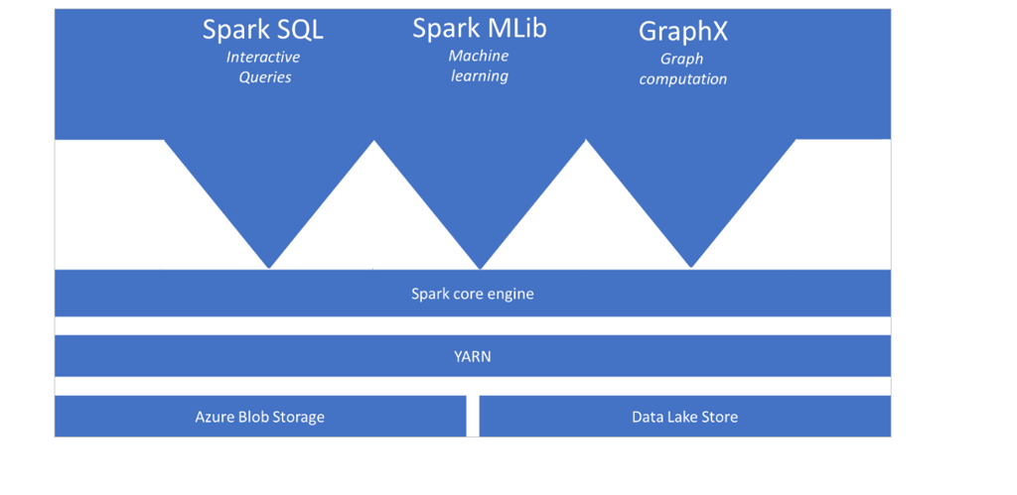
Introduction to Apache Spark
Notes:
Talking Points:
​
Apache Spark:
Apache Spark is a parallel processing framework that supports in-memory processing to boost the performance of big-data analytic applications. ​Apache Spark in Azure Synapse Analytics is one of Microsoft's implementations of Apache Spark in the cloud. Azure Synapse makes it easy to create and configure a Spark pool in Azure Synapse Analytics. Spark pools in Azure Synapse are compatible with Azure Storage and Azure Data Lake Generation 2 Storage, so you can use Azure Spark pools to process your data stored in Azure.​
Spark architecture
The architecture depicted in this slide shows the components of Spark. Spark is compatible with Azure Storage and Azure Data Lake Storage. Apache Spark in Azure Synapse uses YARN Apache Hadoop YARN. Yarn controls the maximum sum of memory used by all containers on each of the Spark nodes.
The spark core engine is a distributed execution engine. On top is the distributed execution engine, you can have different functionalities that can interact with the Spark core engine that you will add as required. Examples include Spark SQL for interactive queries, Spark Mlib for machine learning and GraphX for graph computations. This enables you to set up diverse workloads on a single platform.
​
Instructor notes and guidance.
Note that this architecture is both valid for Apache Spark pools in Azure Synapse Analytics as well as for Azure Databricks. It outlines the general understanding of what Apache Spark is and how it interacts with different services. ​
​
Recommended reading for this slide
https://docs.microsoft.com/en-us/learn/modules/understand-big-data-engineering-with-apache-spark-azure-synapse-analytics/2-what-is-apache-spark-pool

Slide 3
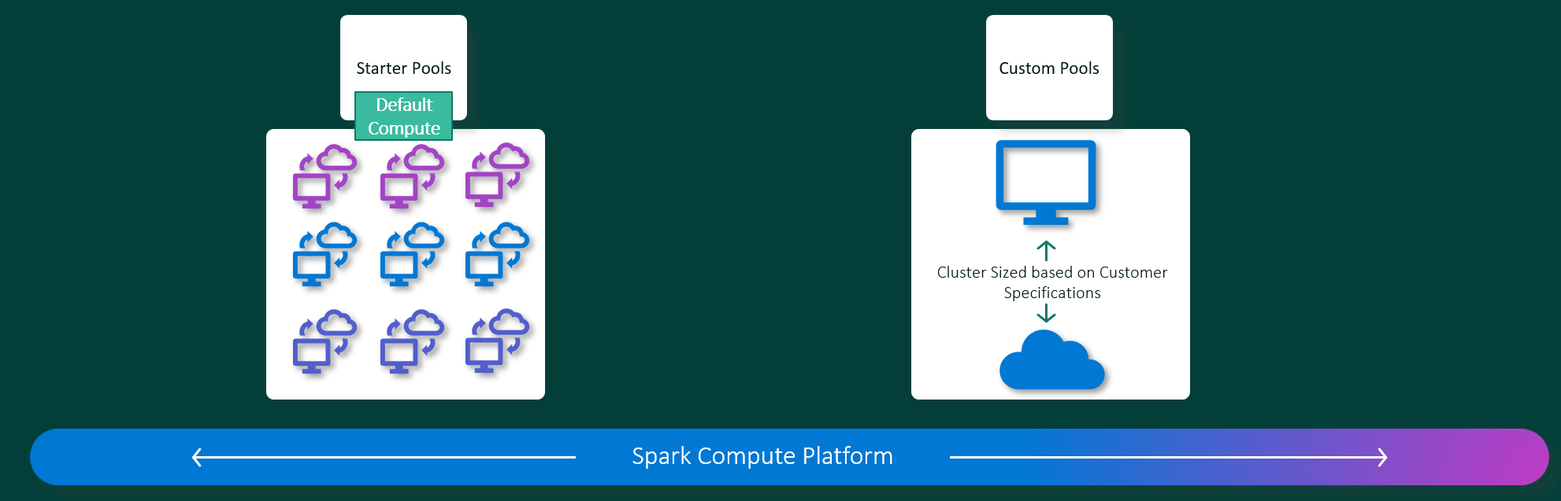
How do Apache Spark pools work in Fabric
Notes:
Talking Points:
Within Azure Synapse Analytics, Apache Spark applications run as independent sets of processes on a pool, coordinated by the SparkContext object in your main program (called the driver program). The SparkContext can connect to the cluster manager, which allocates resources across applications. The cluster manager is Apache Hadoop YARN. Once connected, Spark acquires executors on nodes in the pool, which are processes that run computations and store data for your application. Next, it sends your application code (defined by JAR or Python files passed to SparkContext) to the executors. Finally, SparkContext sends tasks to the executors to run.
The SparkContext runs the user's main function and executes the various parallel operations on the nodes. Then, the SparkContext collects the results of the operations. The nodes read and write data from and to the file system. The nodes also cache transformed data in-memory as Resilient Distributed Datasets (RDDs).
The SparkContext connects to the Apache Spark pool and is responsible for converting an application to a directed acyclic graph (DAG). The graph consists of individual tasks that get executed within an executor process on the nodes. Each application gets its own executor processes, which stay up for the duration of the whole application and runs tasks in multiple threads.
​
Benefits of Spark pools in Azure Synapse Analytics
Some benefits of Spark Pools in Azure Synapse Analytics are as follows:
Speed and efficiency: ​
Spark instances start in approximately 2 minutes for fewer than 60 nodes and approximately 5 minutes for more than 60 nodes. The instance shuts down, by default, 5 minutes after the last job executed unless it is kept alive by a notebook connection.​
​
Ease of creation and use including Pre-Loaded Anaconda libraries​
You can create a new Spark pool in Azure Synapse in minutes using the Azure portal, Azure PowerShell, or the Synapse Analytics .NET SDK. See Get started with Spark pools in Synapse Analytics.​
Synapse Analytics includes a custom notebook derived from Nteract. You can use these notebooks for interactive data processing and visualization.​
Spark REST APIs in Synapse Analytics includes Apache Livy, a REST API-based Spark job server to remotely submit and monitor jobs.​
Spark pools in Azure Synapse come with Anaconda libraries pre-installed. Anaconda provides close to 200 libraries for machine learning, data analysis, visualization, etc.​
​
Support for Azure Data Lake Storage Gen2:​
Spark pools in Azure Synapse can use Azure Data Lake Storage Gen2 as well as BLOB storage. For more information on Data Lake Storage, see Overview of Azure Data Lake Storage.​
​
Scalability:​
Apache Spark in Azure Synapse pools can have Auto-Scale enabled, so that pools scale by adding or removing nodes as needed. ​
Also, Spark pools can be shut down with no loss of data since all the data is stored in Azure Storage or Data Lake Storage.​
​
Instructor notes and guidance.
Note that this architecture is both valid for Apache Spark pools in Azure Synapse Analytics as well as for Azure Databricks. It outlines the general understanding of what Apache Spark is and how it interacts with different services. ​
​
Recommended reading for this slide
https://docs.microsoft.com/en-us/learn/modules/understand-big-data-engineering-with-apache-spark-azure-synapse-analytics/3-how-do-apache-spark-pools-work

Slide 4
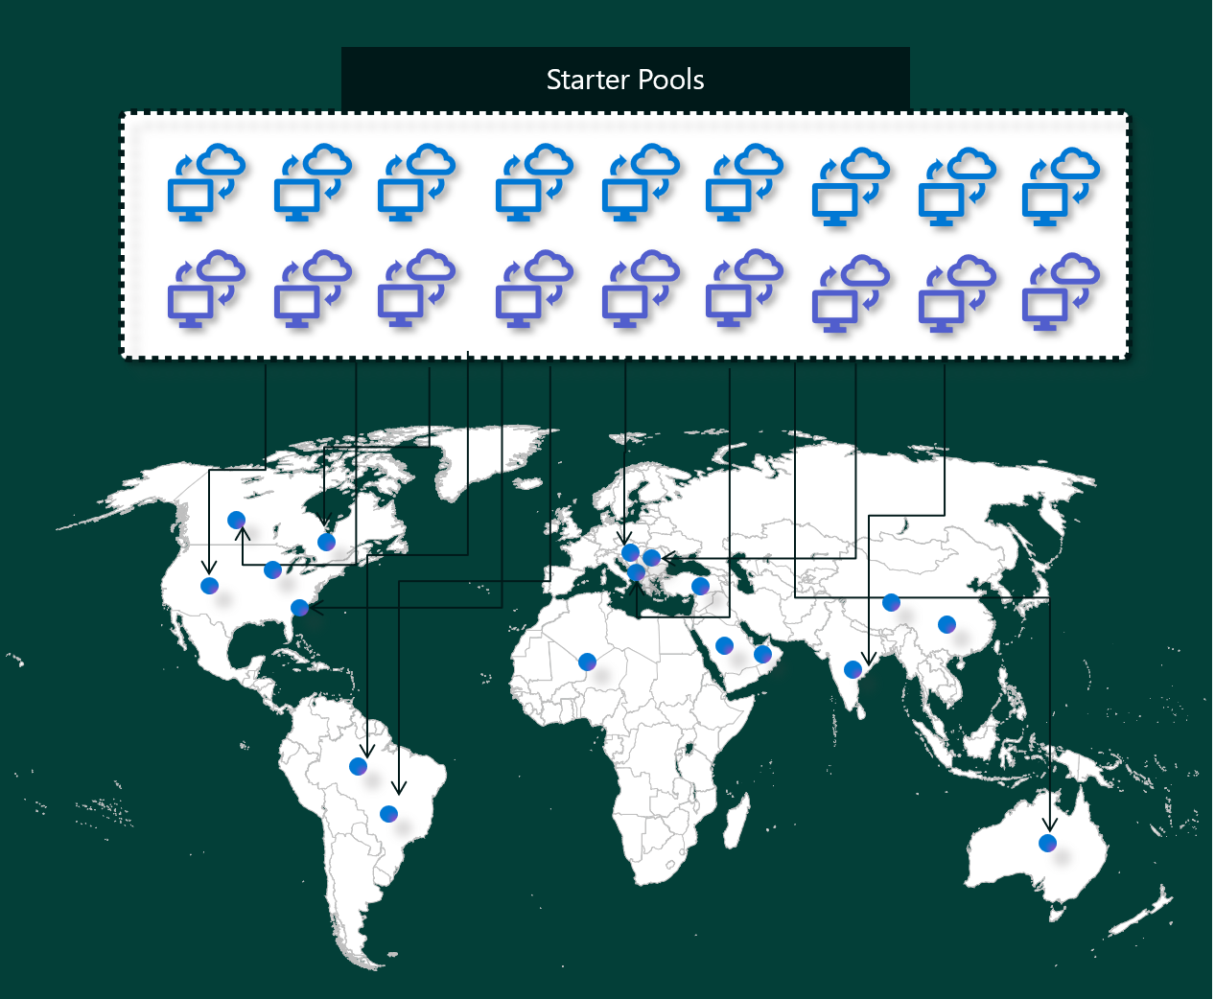
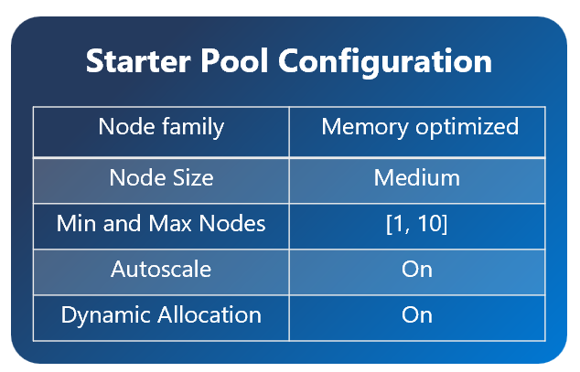
Starter Pools
Notes:
Starter pools are a fast and easy way to use Spark on the Microsoft Fabric platform within seconds. You can use Spark sessions right away, instead of waiting for Spark to set up the nodes for you, which helps you do more with data and get insights quicker.
Starter pools have Spark clusters that are always on and ready for your requests. They use medium nodes that dynamically scale up based on your Spark job needs.
Starter pools also have default settings that let you install libraries quickly without slowing down the session start time. However, if you want to use extra custom Spark properties or libraries from your workspace or capacity settings, it may take longer for Spark to get the nodes for you. When it comes to billing and capacity consumption, you are charged for the capacity consumption when you start executing your notebook or spark job definition. You are not charged for the time the clusters are idle in the pool.

Slide 5
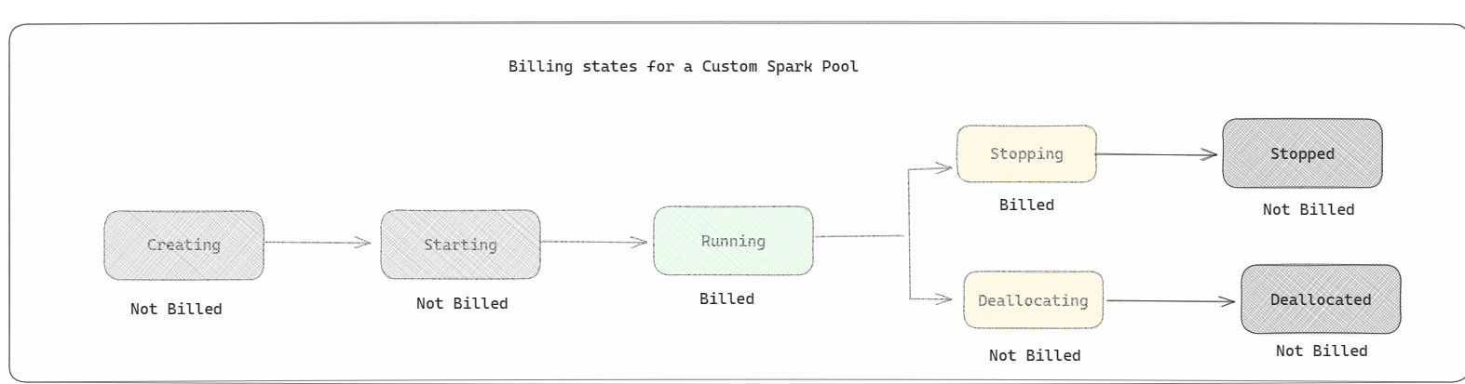
Spark Pools and Fabric Billing
Notes:
A Spark pool is a way of telling Spark what kind of resources you need for your data analysis tasks. You can give your Spark pool a name, and choose how many and how large the nodes (the machines that do the work) are. You can also tell Spark how to adjust the number of nodes depending on how much work you have. Creating a Spark pool is free; you only pay when you run a Spark job on the pool, and then Spark sets up the nodes for you.
If you don't use your Spark pool for 2 minutes after your session expires, your spark pool will be deallocated. This default session expiration time period is set to 20 minutes, and you can change it if you want. If you're a workspace admin, you can also create custom Spark pools for your workspace, and make them the default option for other users. This way, you can save time and avoid setting up a new Spark pool every time you run a notebook or a Spark job. Custom Spark pools take about three minutes to start, because Spark has to get the nodes from Azure.
You can even create Single Node Spark Pools, by setting the min number of nodes to 1, in which case the driver and executor would run in a single node which comes with restorable HA and is suited for small workloads.
The size and number of nodes you can have in your custom Spark pool depends on your Microsoft Fabric capacity. Capacity is a measure of how much computing power you can use in Azure. One way to think of it is that two Spark VCores (a unit of computing power for Spark) equals one capacity unit. For example, a Fabric capacity SKU F64 has 64 capacity units, which is equivalent to 128 Spark VCores. You can use these Spark VCores to create nodes of different sizes for your custom Spark pool, as long as the total number of Spark VCores doesn't exceed 128.

Slide 6
Autoscale for Spark Pools
Allows automation of scale up and down of compute resources based on activity
You specify the minimum and maximum number of nodes
You can change these settings, but you may need restart your instance
Notes:
Autoscale
Autoscale for Apache Spark pools allows automatic scale up and down of compute resources based on the amount of activity. When the autoscale feature is enabled, you set the minimum, and maximum number of nodes to scale. When the autoscale feature is disabled, the number of nodes set remains fixed. This setting can be altered after pool creation, although the instance may need to be restarted.
Dynamic allocation
Dynamic allocation allows the Spark application to request more executors if the tasks exceed the load that current executors can bear. It also releases the executors when the jobs are completed and if the Spark application is moving to idle state. Enterprise users often find it hard to tune the executor configurations because they're vastly different across different stages of a Spark Job execution process. These configurations are also dependent on the volume of data processed, which changes from time to time. Users can enable dynamic allocation of executors option as part of the pool configuration, which would enable automatic allocation of executors to the Spark application based on the nodes available in the Spark pool.

Slide 7
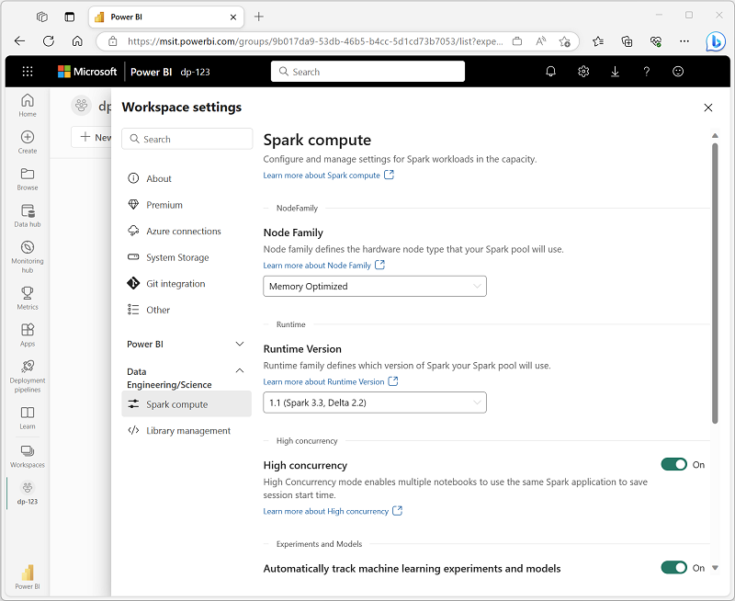
Getting Started with Spark
Each workspace in Fabric is assigned a Spark cluster
An administrator can manage settings under the Data Engineering/Science portion of the workspace settings

Slide 8
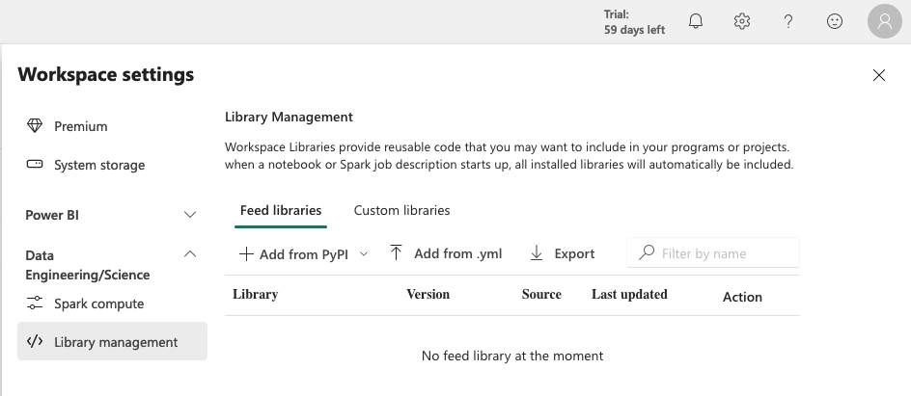
Spark Libraries
Spark includes a wide selection of code libraries by default
Spark clusters in Fabric include many of the most commonly used libraries
You can install additional libraries on the Library management page
Notes:
The Spark open source ecosystem includes a wide selection of code libraries for common (and sometimes very specialized) tasks. Since a great deal of Spark processing is performed using PySpark, the huge range of Python libraries ensures that whatever the task you need to perform, there's probably a library to help.
By default, Spark clusters in Microsoft Fabric include many of the most commonly used libraries, but if you need to install other libraries, you can do so on the Library management page in the workspace settings.

Slide 9
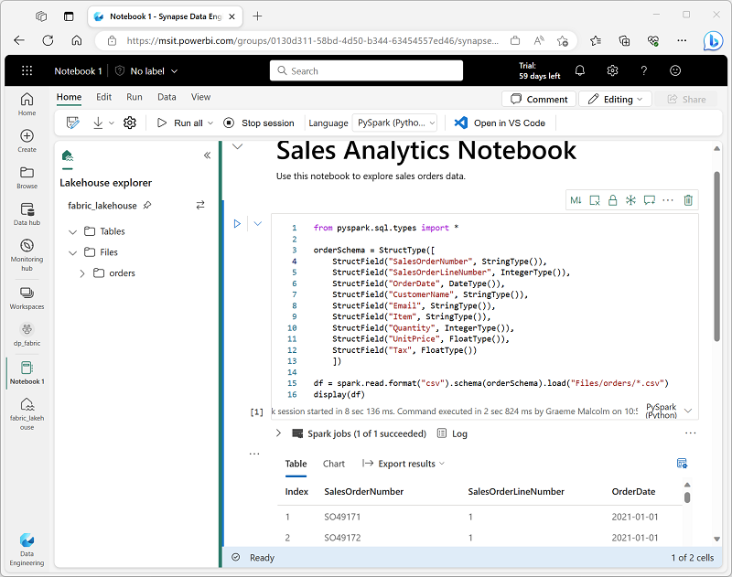
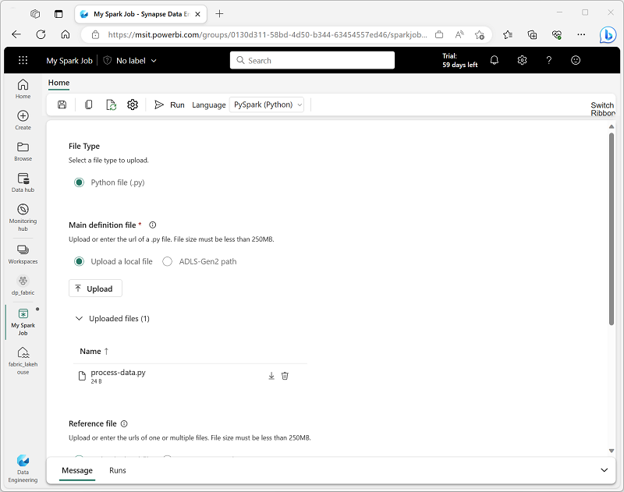
Running Spark Jobs
You have two methods for running Spark jobs in Fabric
Jupyter notebooks
Spark jobs definition
Notebooks are most commonly used to share with others
Jobs are typically used for an automated process
Notes:
Notebooks
When you want to use Spark to explore and analyze data interactively, use a notebook. Notebooks enable you to combine text, images, and code written in multiple languages to create an interactive artifact that you can share with others and collaborate.
Notebooks consist of one or more cells, each of which can contain markdown-formatted content or executable code. You can run the code interactively in the notebook and see the results immediately.
Spark job definition
If you want to use Spark to ingest and transform data as part of an automated process, you can define a Spark job to run a script on-demand or based on a schedule.

Slide 10
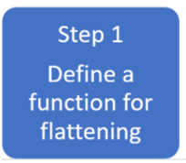
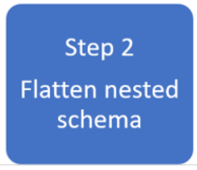
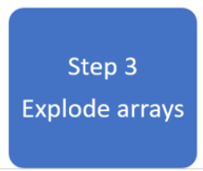
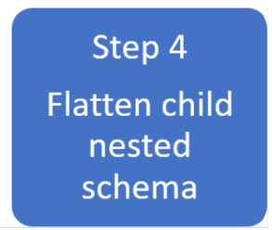

Working with Spark DataFrames in Microsoft Fabric
Notes:
TALKING POINTS
A common use case for using Apache Spark pools in Azure Synapse Analytics is for transforming complex data structures using DataFrames. It can help for the following reasons:
Complex data types are increasingly common and represent a challenge for data engineers as analyzing nested schema and data arrays tend to include time-consuming and complex SQL queries.
It can be difficult to rename or cast the nested column data type.
Performance issues arise when working with deeply nested objects. Data Engineers need to understand how to efficiently process complex data types and make them easily accessible to everyone. In the following example, Synapse Spark is used to read and transform objects into a flat structure through data frames.
Synapse SQL serverless is used to query such objects directly and return those results as a regular table.
With Synapse Spark, it's easy to transform nested structures into columns and array elements into multiple rows.
In the example the following steps show the techniques involved to deal with complex data types by creating multiple DataFrames to achieve the desired result.
Step 1: Define a function for flattening
We create a function that will flatten the nested schema.
Step 2: Flatten nested schema
We will define the function you create to flatten the nested schema from one DataFrame into a new DataFrame.
Step 3: Explode Arrays
Here you will transform the data array from the DataFrame created in step 2 into a new DataFrame.
Step 4: Flatten child nested Schema
Finally, you use the transformed DataFrame created in step 3 and load the cleansed data into a destination DataFrame to complete the work
​Instructor notes and guidance.
For students it’s important to understand how to transform complex data with DataFrames in Apache Spark Pools. This slide gives you an overview of the step-by-step approach you would take to flatten a nested structure. The lab will enable the students to use the detailed steps of this process.
​
​
Recommended reading for this slide
https://docs.microsoft.com/en-us/learn/modules/transform-data-with-dataframes-apache-spark-pools-azure-synapse-analytics/

Slide 11
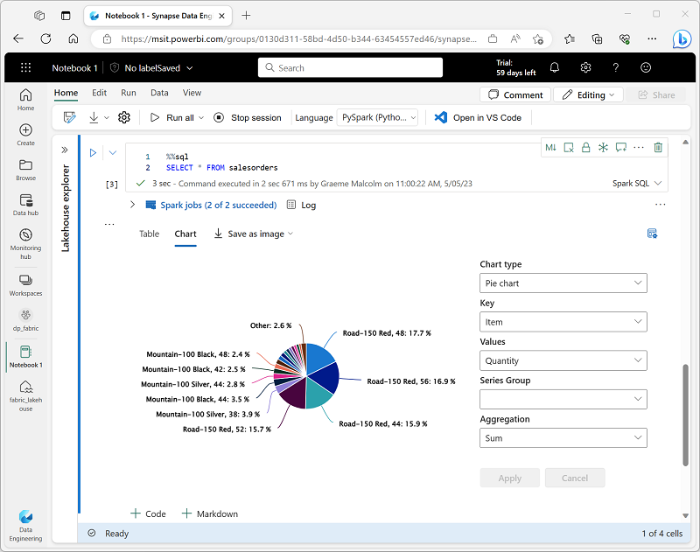
Working with Spark Data
You can use the Spark SQL API to query data
You can also use Spark notebooks to visualize data within the notebook
Notes:
The Dataframe API is part of a Spark library named Spark SQL, which enables data analysts to use SQL expressions to query and manipulate data.
Creating database objects in the Spark catalog
The Spark catalog is a metastore for relational data objects such as views and tables. The Spark runtime can use the catalog to seamlessly integrate code written in any Spark-supported language with SQL expressions that may be more natural to some data analysts or developers.
One of the most intuitive ways to analyze the results of data queries is to visualize them as charts. Notebooks in Microsoft Fabric provide some basic charting capabilities in the user interface, and when that functionality doesn't provide what you need, you can use one of the many Python graphics libraries to create and display data visualizations in the notebook.
Using built-in notebook charts
When you display a dataframe or run a SQL query in a Spark notebook, the results are displayed under the code cell. By default, results are rendered as a table, but you can also change the results view to a chart and use the chart properties to customize how the chart visualizes the data, as shown here:

Slide 12
Summary
Spark is a very popular tool for a variety of data science and data engineering tasks
You can interact with data in Spark a number of ways including SparkSQL, Python, Scala, and Notebooks
Fabric allows you to define notebooks and jobs depending on your requirements

Slide 13

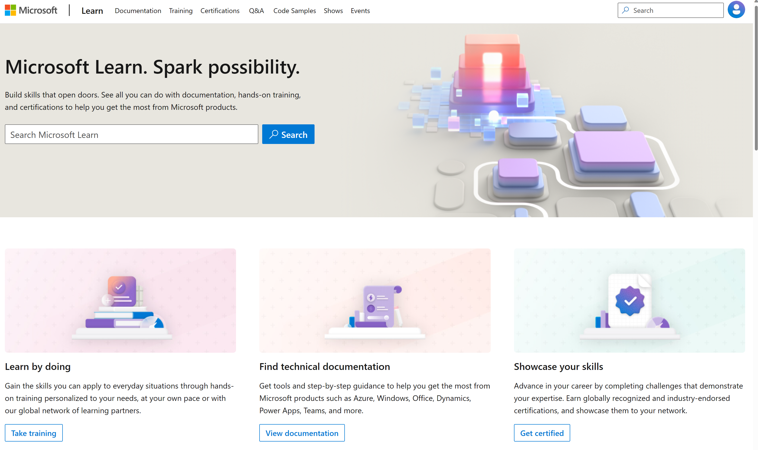
Microsoft Learn Demo
Microsoft Learn: Build skills that open doors in your career

Slide 14
Readiness and Enablement Links
The Microsoft Federal Team is here to help you accelerate customers' digital transformation. Microsoft Federal has tailored to make your organizations skilling journey successful. From the Business Decision Maker to the technical community and end-users, Microsoft provides customers with access to endless skilling resources. Below you will find links to these resources:
Get training tailored to your organization's needs: Find learning paths for specific roles in your organization, plus course recommendations based on technology, skill level, and solution area: Training | Learning Portal (microsoft.com)
Events Calendar - US Partner Community Blog – Microsoft
In addition to the above, the Microsoft Federal Team can address the needs of your non-technical community of your learners through:
Skilling Hours - Readiness and Enablement: Skilling our Federal Customers and Partners (office.com)
Microsoft Learning Portal: A closer look at Azure through training modules and gamified learning
Microsoft Learning Portal
Additional Learning Resources:
Get started with Azure – Introduction | Microsoft Azure
Microsoft Learn (path-based)
Exam-based: Select filters: Azure, D365, M365, Power Platform, and more
Microsoft Virtual Training Days – Virtual Instructor Led
Microsoft Technology Center - Work through your Account Manager
Home - Microsoft Tech Community
Microsoft Reactor | Microsoft Developer – Virtual Instructor Led

